Slide 1
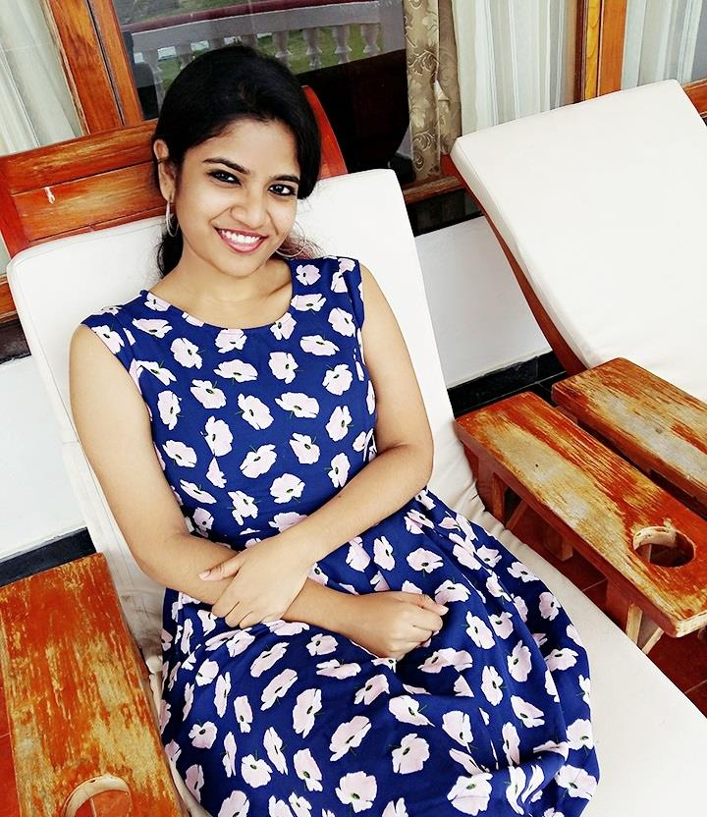
Anjana Sherin Thangadurei
What makes you feel empowered to be a woman??
The fact that the physically
weaker sex is the mentally stronger one

Slide 2
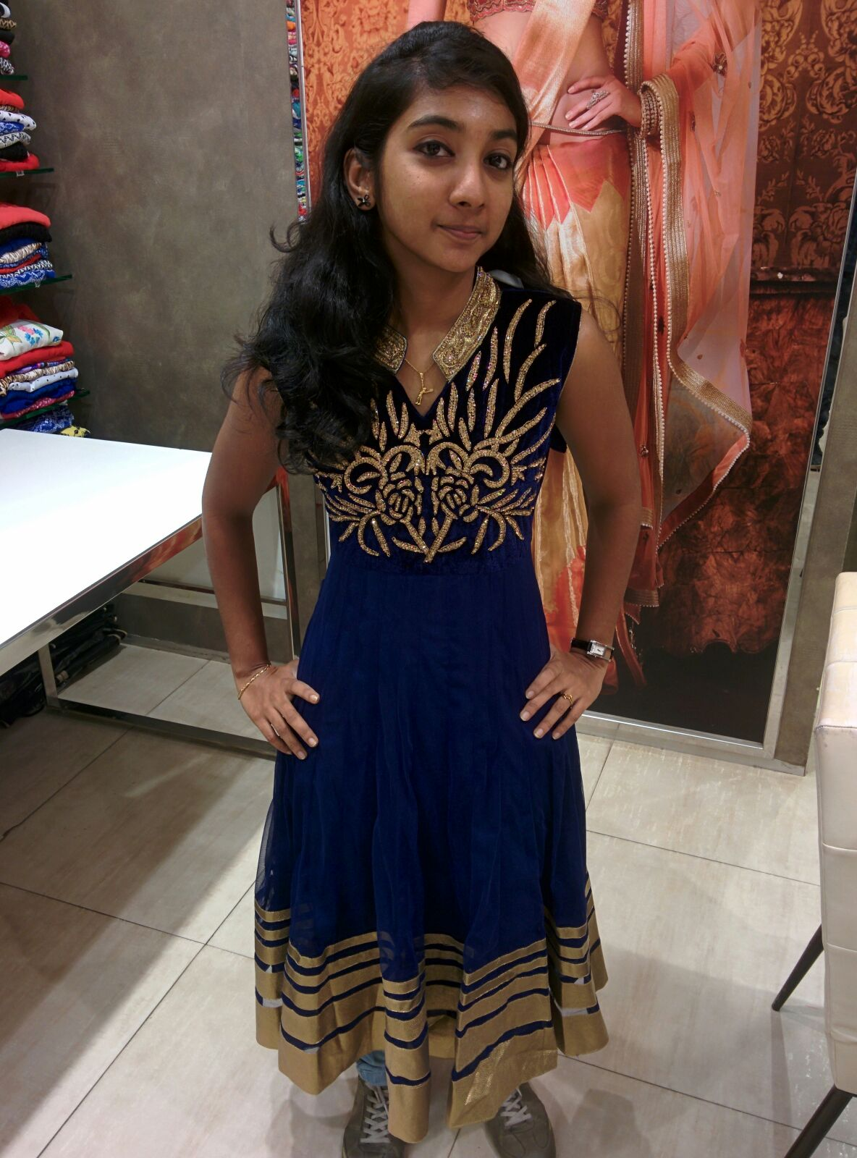
Preetha Sudhakaran
What makes you feel empowered to be a woman??
Life and family can never be happy without a
WOMAN

Slide 3
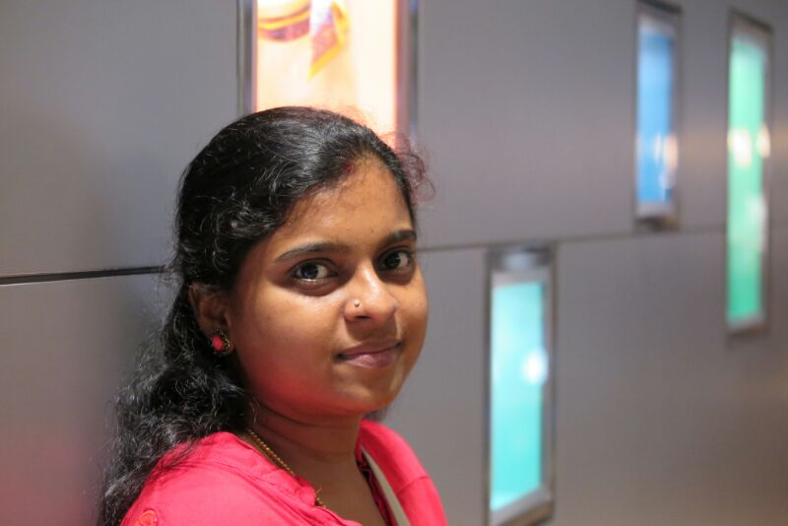
Sharanya Suresh
What makes you feel empowered to be a woman??
Am proud to be a woman because of the very important fact that she is the medium for the creation of human being in this world. God himself has kept the trust on women to act as his medium for the creation of human being.
Mahatma Gandhi has said, "If you educate a man, you educate an individual, but if you educate a woman, you educate the whole family".
So that means women are highly responsible and she does not only look after herself but look after her parents, in-laws, siblings, husband and children.

Slide 4
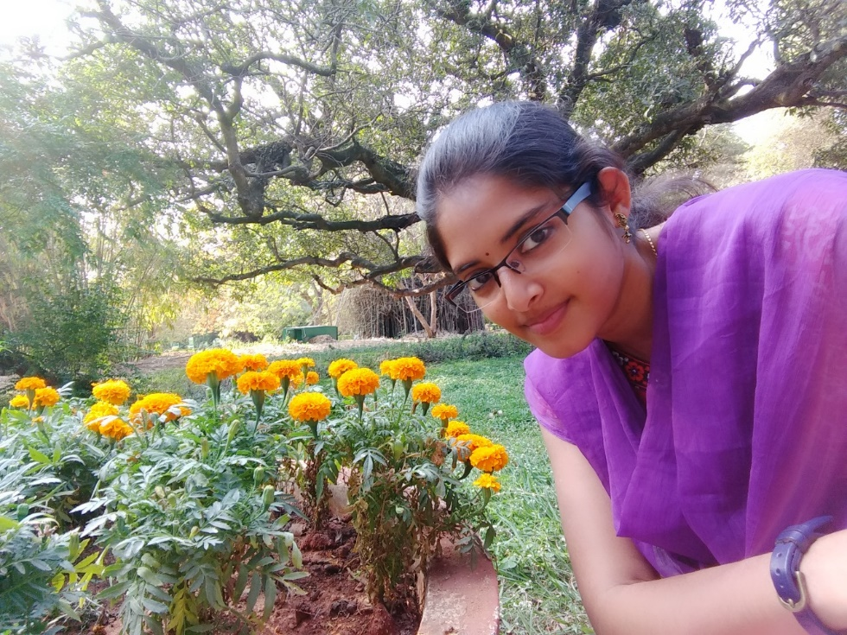
Satya Vetri
What makes you feel empowered to be a woman??
To be honest, Women Empowerment is not about just about enforcing or training the society about the importance and the ability of Women. It should all start primarily from one’s birth, where the parents and family take stern steps in educating their children on the Women’s role in the family and the society. It should be nurtured within each child (let it be a girl or a boy) - that Women are equally competent to Men. Having been evolved in a male chauvinistic society, I feel Women Empowerment is completely achievable - only when the gender inequality and the male dominance is demolished from our society. I’m currently enjoying some percentage of Women Empowerment, let the future generation have it 100% J.
Of all, as a Women I strongly believe “Women can achieve anything” and it is proven across. So let’s start believing ourselves and discover ourselves to amaze the world with our ability.

Slide 5
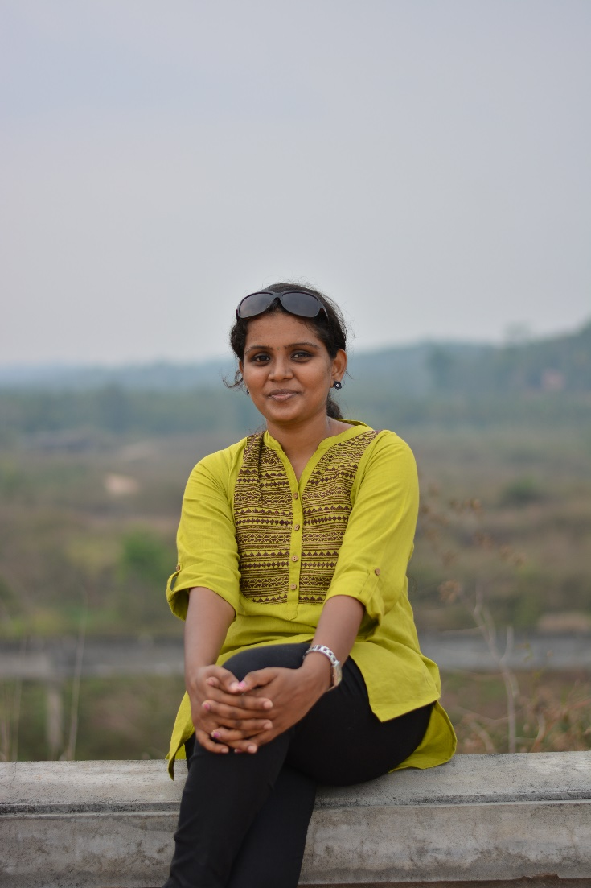
Rekha Dhinagaran
What makes you feel empowered to be a woman??
Achieving the goals and dreams with constant hard work and determination making others proud makes me feel great! Taking decisions and earning on my own without depending on others is a great thing. Yes, I am a woman, being independent and confidence in whatever I do makes me feel more empowered.

Slide 6
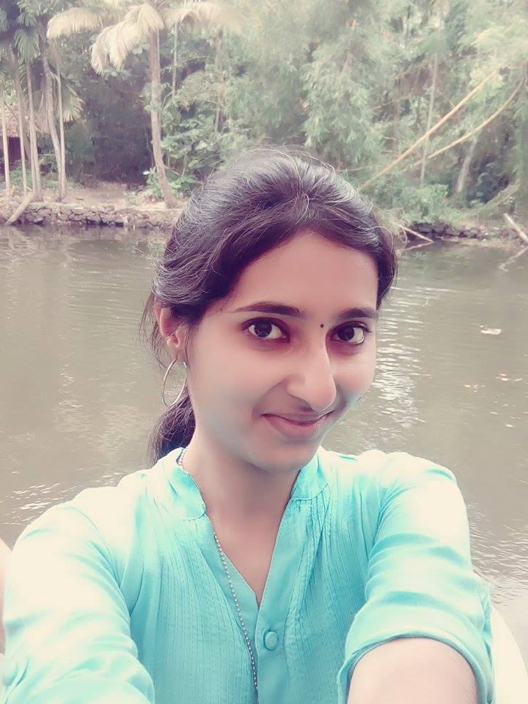
Sreenidhi Srinivasan
What makes you feel empowered to be a woman??
Being a woman makes me feel empowered because, a woman knows not only what she wants, but also sacrifices a lot to suffice others’ needs. She keeps people around her happy always. She fights back many barriers in the society to prove herself successful.

Slide 7
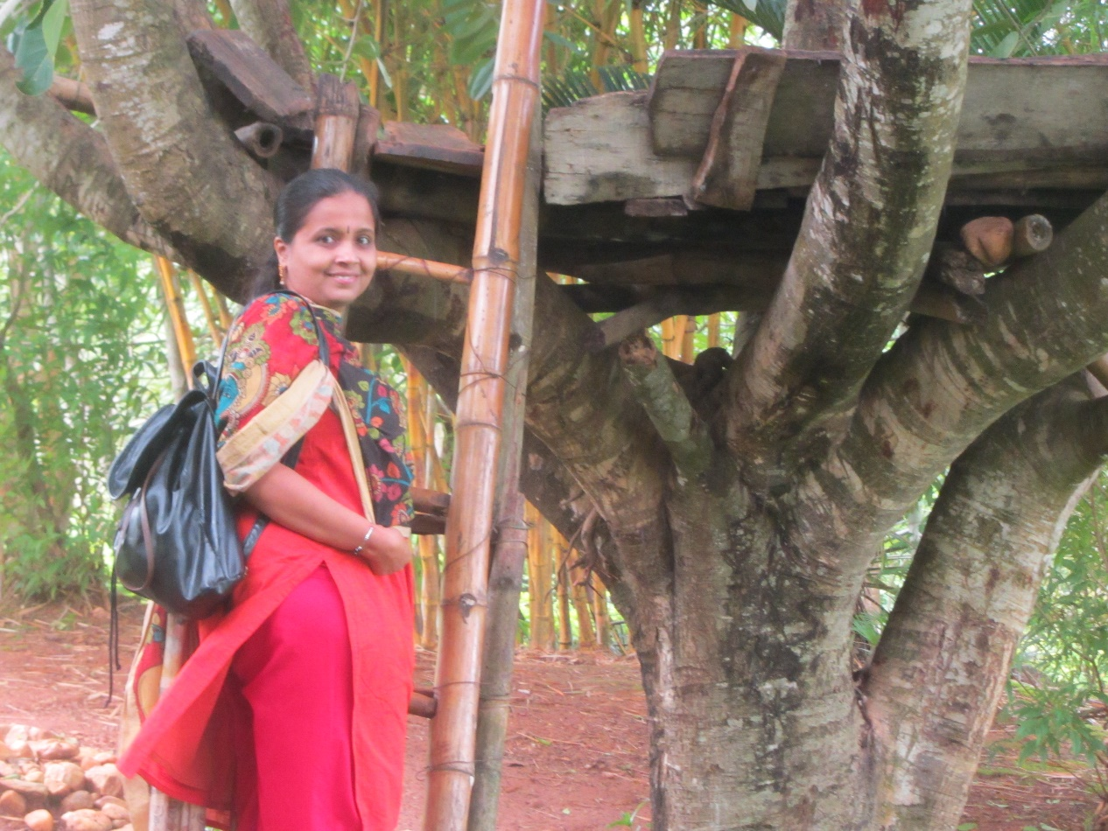
Lalitha Arun
What makes you feel empowered to be a woman??
Positivity, perseverance, self-belief, imbibing the good qualities of great people around and finally following my heart

Slide 8
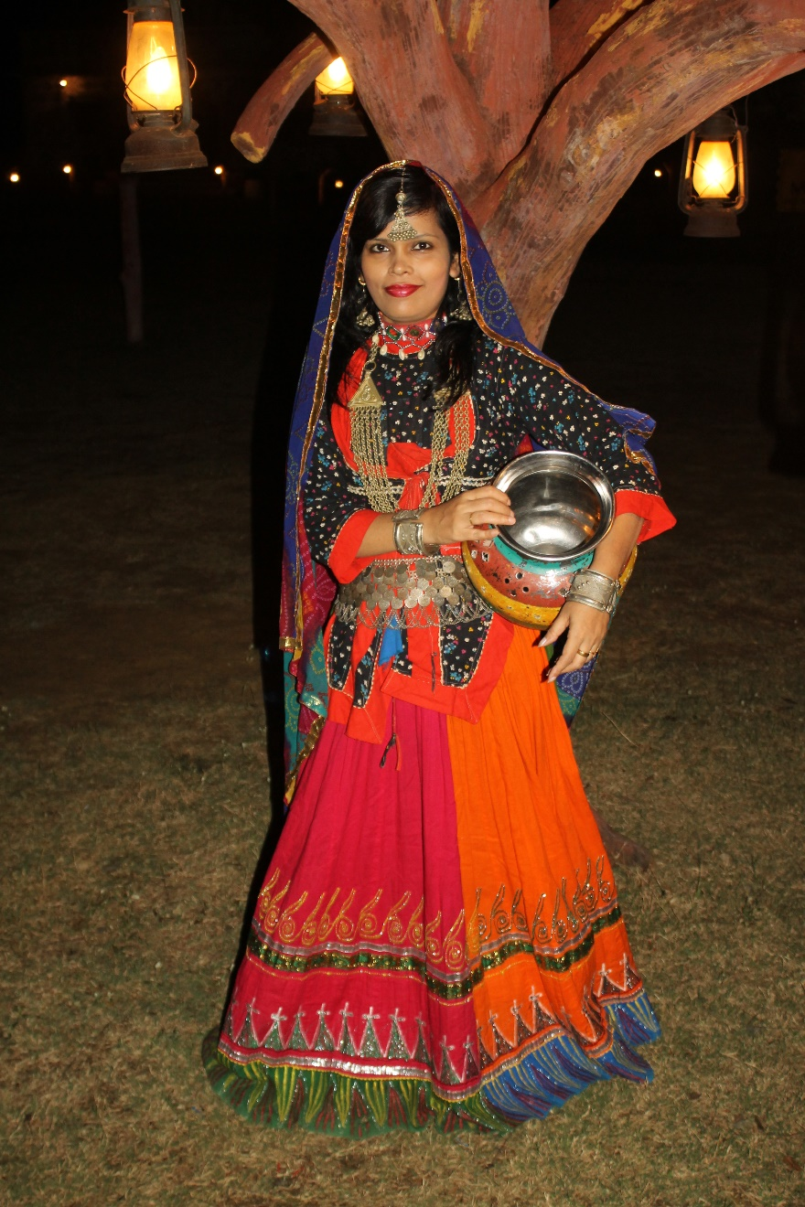
Julia Barnes
What makes you feel empowered
to be a woman??
A woman is WORTH it ! The only person to call out when you get hurt is “Mummy”. A Woman is Caring, Loving, Gentle, Persevering and a great multi-tasker.

